Slide 1

Orion’s Quest
Navigating the Cyber Wilderness
Kevin Johnson
kevin@secureideas.com
904-403-8024
@secureideas

Slide 2
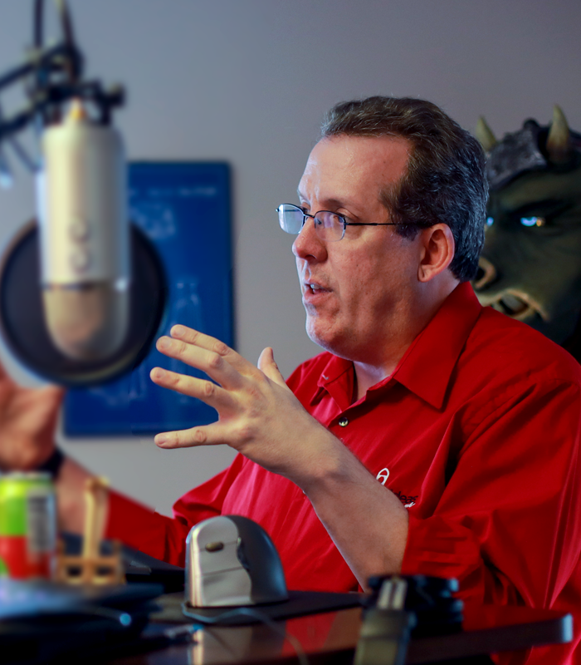
Kevin Johnson
CEO - Secure Ideas, LLC
Founded in 2010
IANS Faculty member
Since 2011
Open-Source Fanatic
OWASP Global Board Member
Project Builder and Founder
Speaker, Course Instructor, Author
Since 1991
SANS, ISC2, OWASP, DEF CON, Blackhat, etc.
Other Interests
Woodworking
Business and Team
Father

Slide 3
Agenda
Orion’s Quest
Web Applications
Physical Posture
Attacking the Defenders

Slide 4
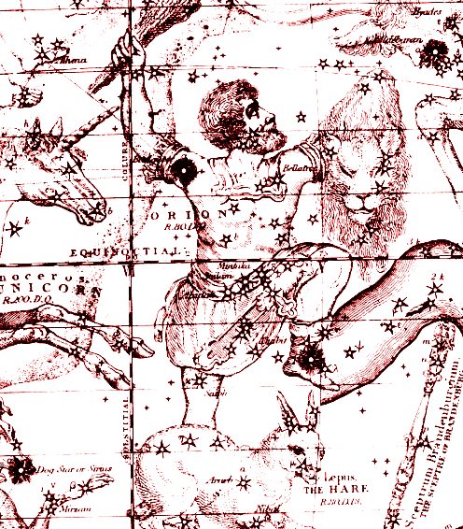
Orion’s Quest
Orion was a hunter
Immortalized in the stars
Penetration Testers are also
Bug hunters
Hat tip to Jason Haddix
To often we are check box checkers
Or treated as such
We should guide the organization
Recognizing that they are in business to business
This Photo by Unknown Author is licensed under CC BY-NC-ND

Slide 5

Web Applications
Applications are a common target
They have data and access
Story Time:
Membership application
Data galore
Captive Portal
From the guest to the domain

Slide 6

Physical Attacks
Evaluating the controls
NOT police response time
Scope is the MOST critical
An escort is awesome
Story time:
Hospital offices
Data was used in calls to the helpdesk
Bank data center
Accessed via weak door controls

Slide 7

Attacking the Defenders
Security is often the weakest link
We know better
Story Time
Automated Tools and Scanners
Domain Admin Credentials
Over-confident Staff
Passwords and resets
This Photo by Unknown Author is licensed under CC BY-SA-NC

Slide 8

Wrapping it Up
We must light the way
We support our orgs and people
Do the right things
Not just what you want
Learn constantly
Adjust your beliefs and knowledge

Slide 9
Questions?

